Slide 1
Maximizing Inventory Efficiency through Advanced Analytics
Subhasish Das, Raahul Bharath, Sanath Kumar Bennur

Slide 2
AGENDA
Company Overview.
Problem Statements.
Goals and Objectives.
Top Products
Pareto Analysis.
Market Basket Analysis.
Insights and Recommendations.
Appendix:
Data Description

Slide 3

Company Overview
OList is a dynamic e-commerce company that has recently encountered some financial challenges. To address these issues, the company is focused on optimizing its inventory management processes to minimize unnecessary costs and improve overall efficiency. By refining their approach to inventory control, OList aims to enhance profitability while maintaining high customer satisfaction and market competitiveness.

Slide 4
PROBLEM STATEMENT
Manage the inventory costs for OList, an e-commerce company facing financial challenges.
Identify the top products contributing to the overall revenue.
Conduct market basket analysis to understand customer purchase behavior.
Estimate which items will likely be purchased individually or in combination with other products.
Pareto Analysis.

Slide 5

Goals & objectives
Identify and focus on top-selling products that significantly contribute to revenue.
Analyze customer purchase patterns using market basket analysis.
Predict product combinations and individual purchases to improve cross-selling opportunities.
Apply Pareto analysis to prioritize products based on their impact on revenue and costs.
Optimize inventory management to reduce costs for OList.

Slide 6
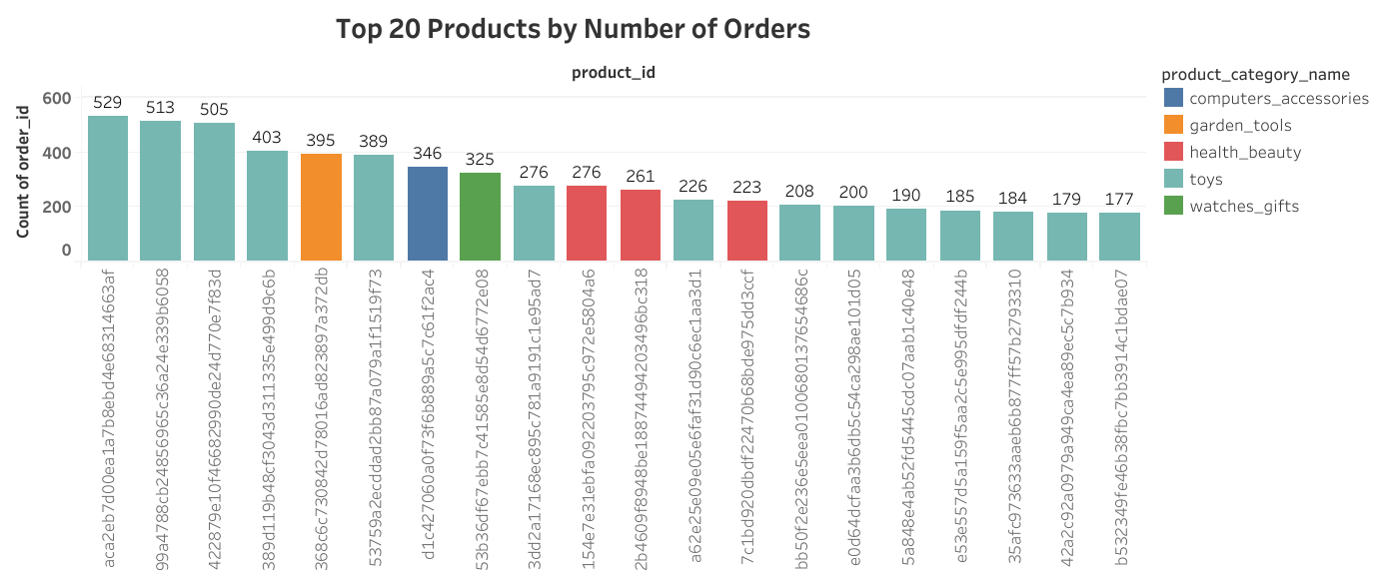
Top 20 Products by Number of Orders
The product with ID 99a4788cb24856965c36a24e339b6058 has the second-highest number of orders, totaling 513.
The product with ID aca2eb7d00ea1a7b8ebd4e68314663af has the highest number of orders, totaling 529.
The product with ID 422879e10f46682990de24d770e7f83d ranks third with 505 orders.

Slide 7
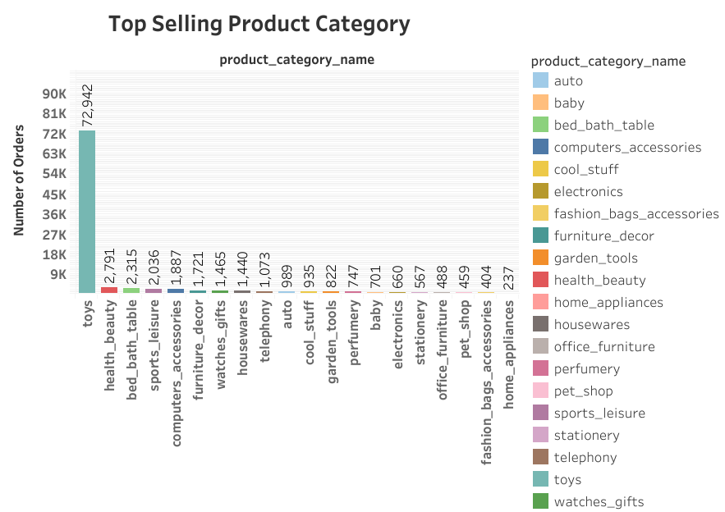
Top-selling product category
Toys are the top-selling product category, followed by Health_Beauty, and then Bed_Bath_Table.

Slide 8
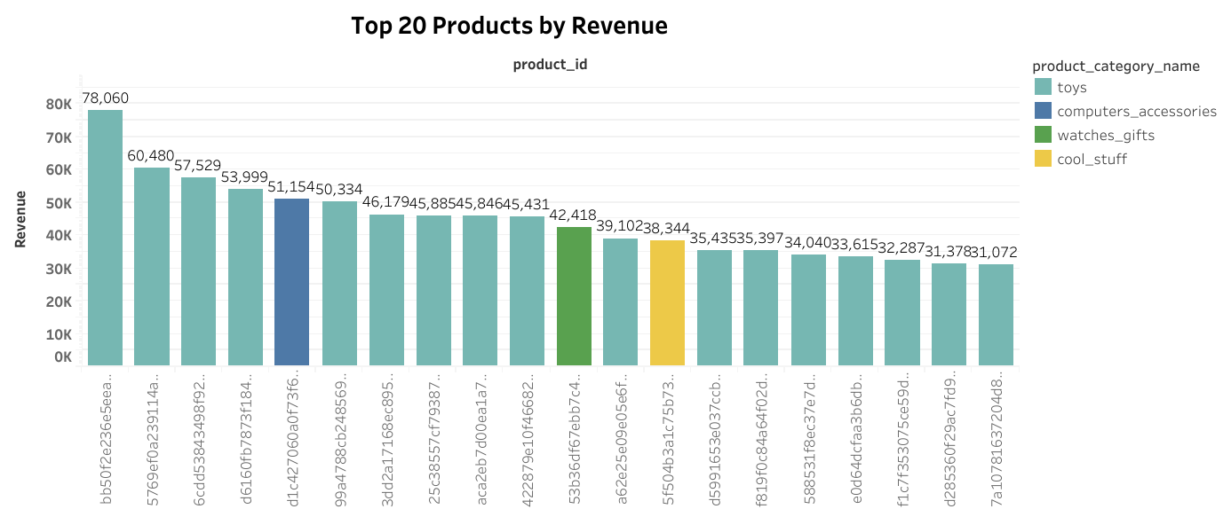
Top 20 Products by revenue
Product ID bb50f2e236e5eea0100680137654686c generates the highest revenue among the top 20 products, totaling approximately 78K.
Product ID 5769ef0a239114ac3a854af00df129e4 ranks second in revenue generation among the top 20 products, with a total of approximately 60K.
Product ID 6cdd53843498f92890544667809f1595 holds the third position for revenue among the top 20 products, with a total of approximately 57K.

Slide 9
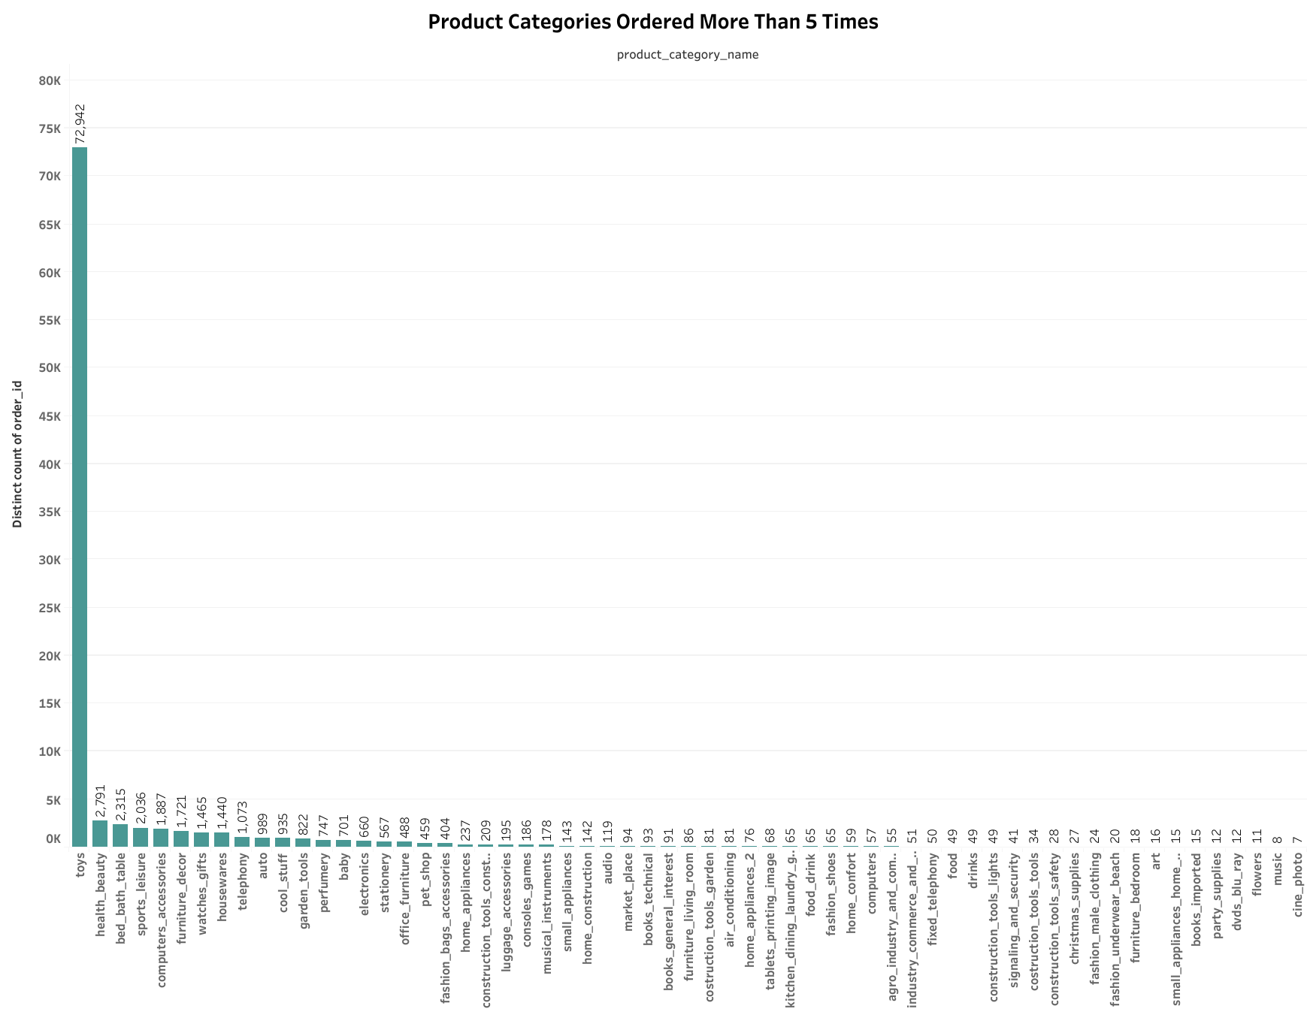
Product categories with more than 5 orders
The "Toys" category dominates and surpasses all other categories solidifying its position as a top-selling product.
Categories like "Health_Beauty," and "Bed_bath_table show relatively high order volumes, though they trail significantly behind the dominant "Toys" category.

Slide 10
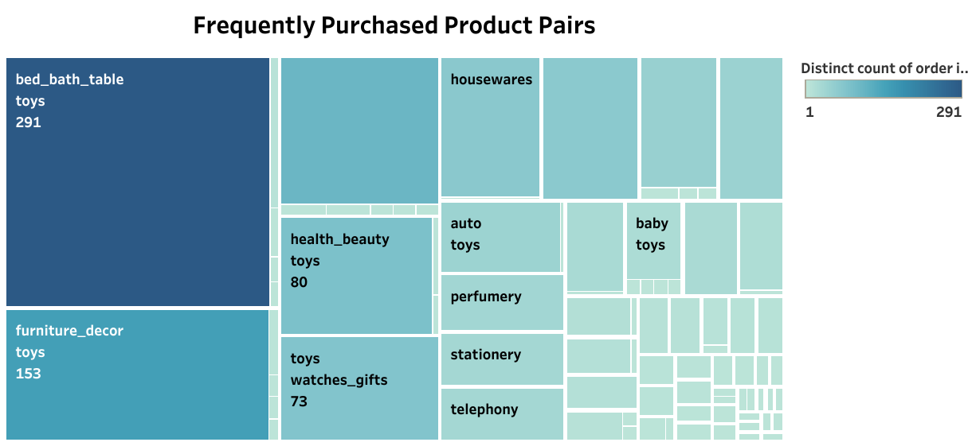
Frequent Product Pairs (Market Basket Analysis)
Market basket analysis reveals that "Toys" and "Bed_Bath_Table" were purchased together 291 times.
"Toys" and "Furniture_Decor" were bought together 153 times, while "Toys" and "Computer_Accessories" were combined 103 times.
These insights help identify popular product combinations, inform targeted marketing strategies, and optimize product placement.

Slide 11
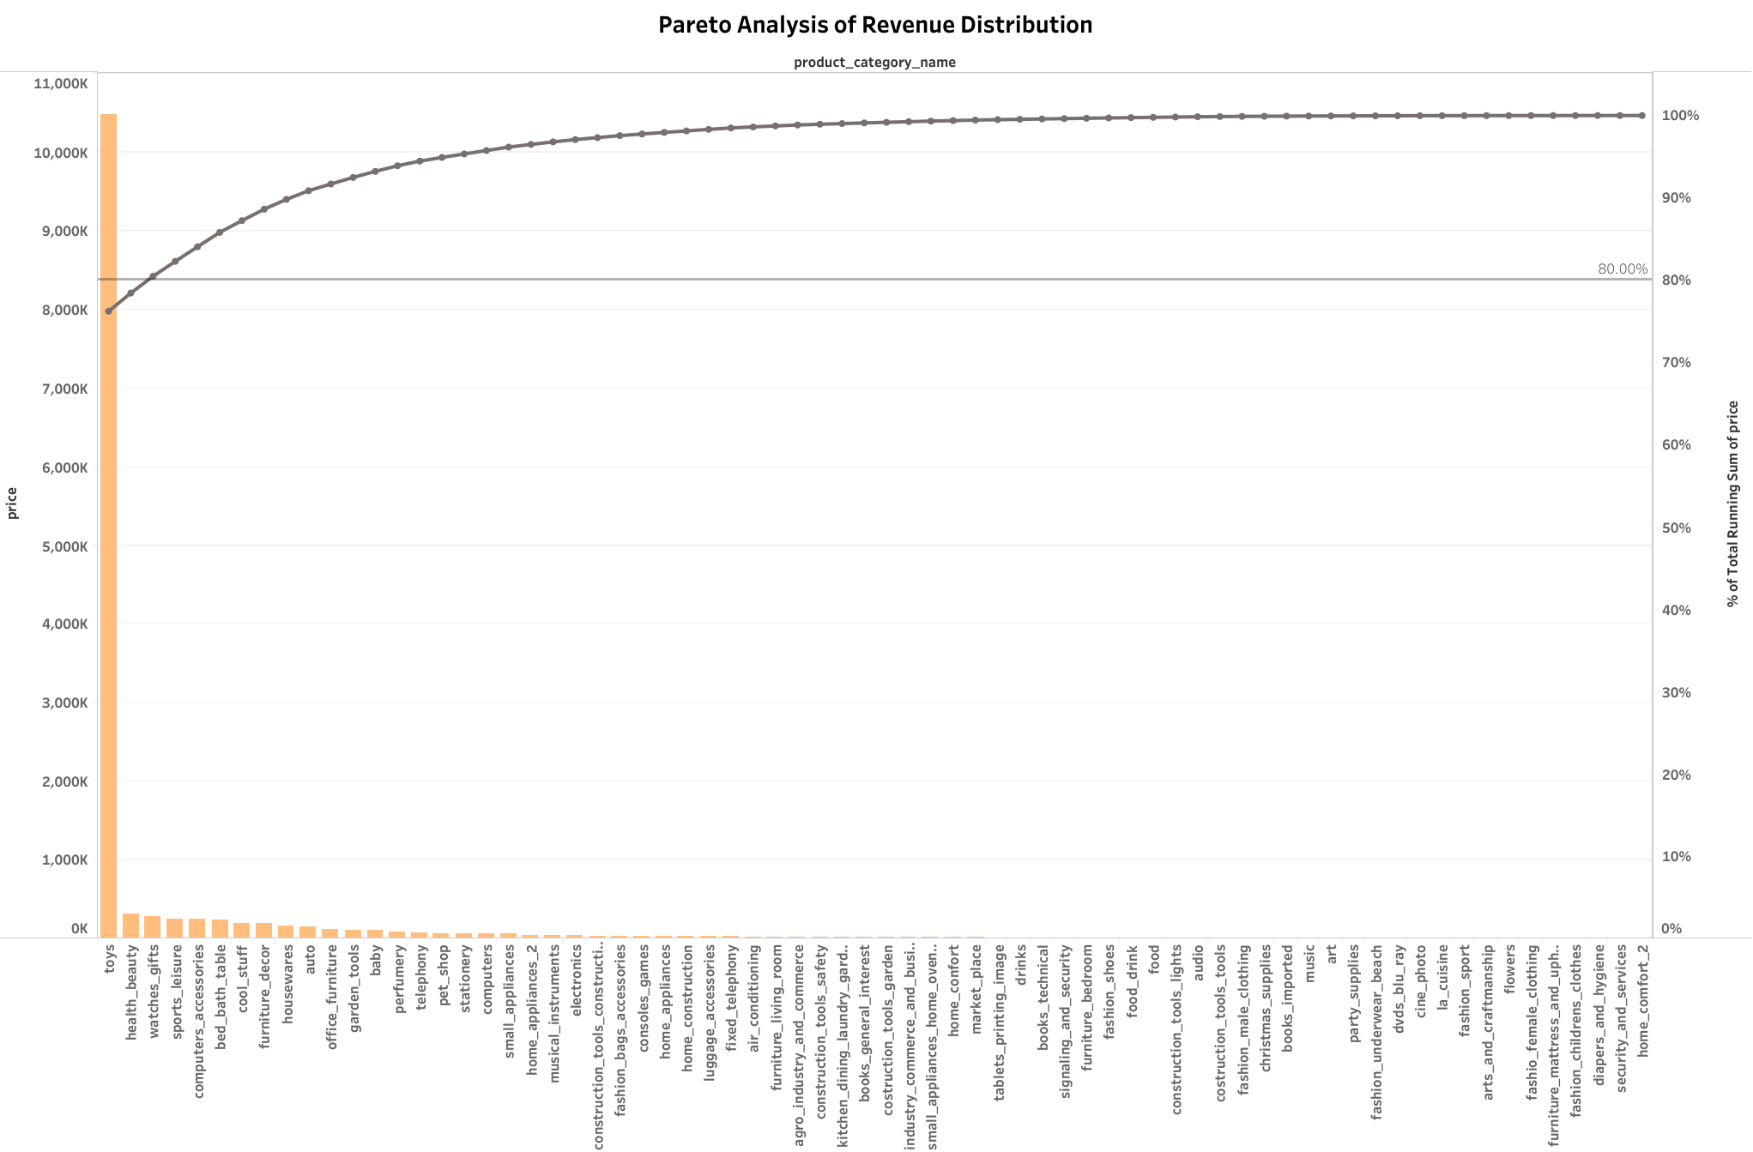
Pareto analysis of revenue distribution
The top three product categories—"Toys,“ "Health_Beauty," and "Watches_Gifts"—make up 80.48% of total revenue, indicating they are high-priority inventory items requiring close monitoring.
The remaining 19.52% of revenue can be divided into medium and low-priority groups based on their order volume.
This inventory prioritization helps focus on top-selling items while managing other categories efficiently, optimizing inventory management, and reducing costs.

Slide 12
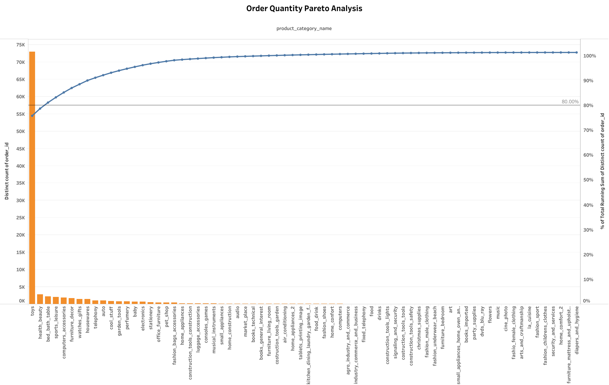
Pareto Analysis of Order Volume
The top three product categories—"Toys," "Health_Beauty," and "bed_bath_table"—account for 81.17% of total orders, highlighting them as high-priority inventory items that require close monitoring.
The remaining 18.83% of revenue can be categorized into medium and low-priority groups based on order volume.
This inventory prioritization enables a focus on top-selling items while efficiently managing other categories, leading to optimized inventory control and cost reduction.

Slide 13
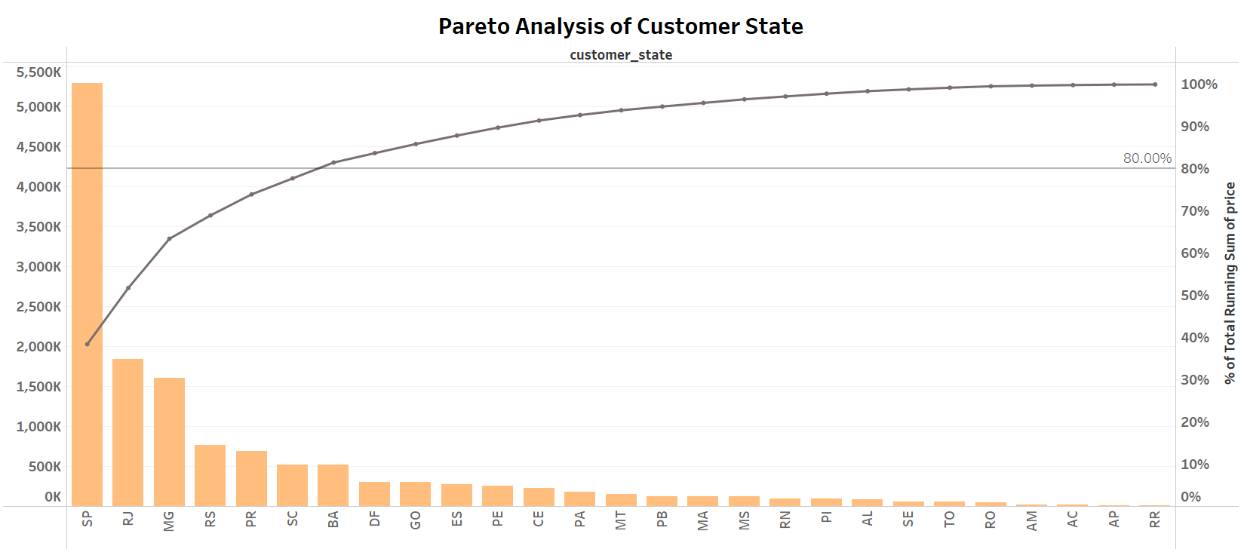
Pareto analysis of customer state
The states of SP, RJ, MG, RS, PR, SC, and BA contribute to 81.49% of total sales, indicating these regions are critical for business focus and strategy.
Focusing on these key states can help in optimizing inventory management, enhancing customer engagement, and driving targeted marketing efforts to maximize revenue.

Slide 14
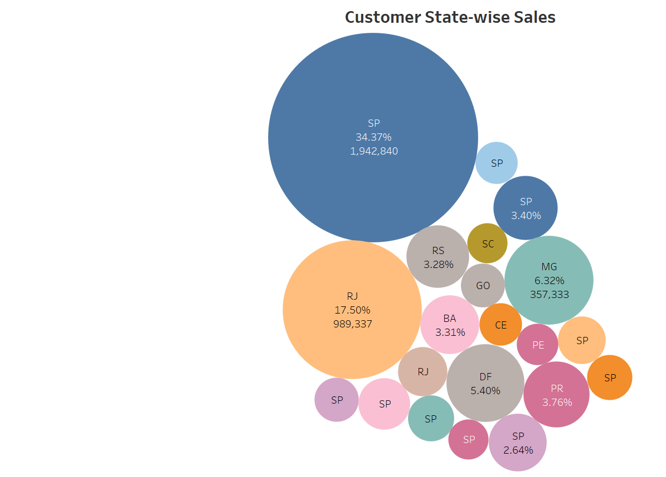
State-Wise Sales Performance
State SP accounts for the highest share, contributing 34.37% of the total sales. RJ follows with 17.50%, and MG contributes 6.32% of the total sales.
Highlighting these key states can help focus marketing and inventory efforts in the regions that drive the most sales.

Slide 15
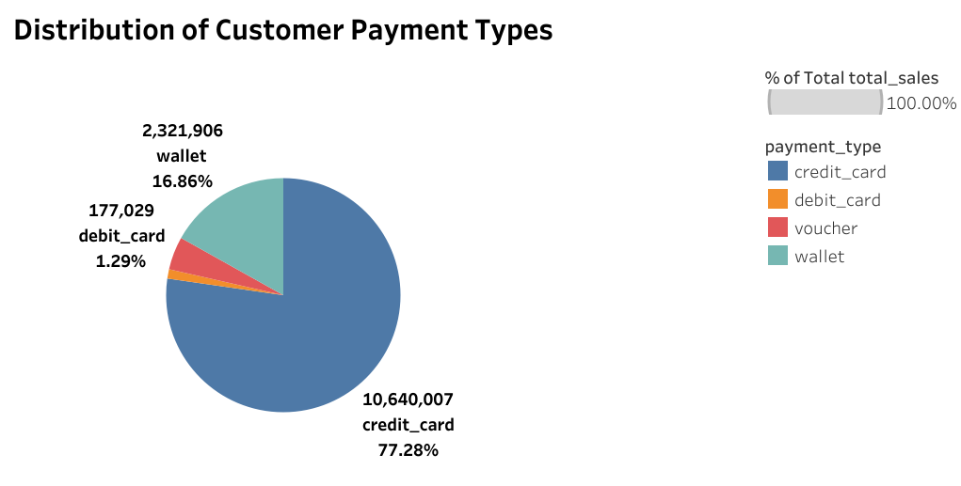
Customer payments mode
The most preferred method of payment among customers is the credit card, accounting for 77.28% of all transactions. This is followed by wallet payments at 16.86%, vouchers at 4.57%, and debit cards at 1.29%.
Focus on maintaining a smooth and secure credit card payment process, as it is the most preferred method.
Enhance wallet integration options to encourage more usage and attract tech-savvy customers.

Slide 16
Insights
The dataset includes transactions over a span of 23 months and November 2017 had the highest number of user purchases.
The "Toys" category is a high-priority inventory item, contributing significantly to total orders and revenue.
Market Basket Analysis reveals that "Toys" and "Bed_Bath_Table" are frequently purchased together, suggesting that placing these products together could boost sales.
"Toys," "Health_Beauty," and "Watches_Gifts"—comprise 80.48% of total orders, indicating they should be prioritized and closely monitored.

Slide 17
Insights
The states SP, RJ, MG, RS, PR, SC, and BA account for 81.49% of total sales, making them critical regions for business focus and strategy.
The most preferred payment method is Credit Card, used in 77.28% of all transactions.
Least sold: home_comfort_2, security_and_services,and diapers_and_hygiene.

Slide 18
recommendation
Focus on High-Priority Categories: Optimize inventory by concentrating on top categories like Toys, Health_Beauty, bed_bath_table and Watches_Gifts and reducing infrequent products.
Leverage Product Pairing: Position Toys and Bed_Bath_Table together to boost sales from frequent co-purchases.
Target Key Regions: Focus marketing and sales strategies on top-performing states (SP, RJ, MG, RS, PR, SC, BA), especially SP (34.37% of sales).
Reassess Low-Performers: Consider phasing out or repositioning low-selling categories like home_comfort_2 and security_and_services.
Promote Credit Card Use: Encourage credit card transactions through incentives, given their popularity (77.28% of payments).

Slide 19
appendix

Slide 20
Data description
Retail_dataset (Excel file with 5 sheets):
Orders: Details on order ID, customer ID, order status, and timestamps (purchase, approval, delivery).
Order_Items: Order-specific details including item ID, product ID, seller ID, price, and shipping charges.
Customers: Customer ID, zip code prefix, city, and state.
Payments: Order ID, payment type, installments, and payment value.
The dataset covers transactions from September 2016 to August 2018.
Includes 93,056 customers with a total of 96,155 orders placed.

Slide 21
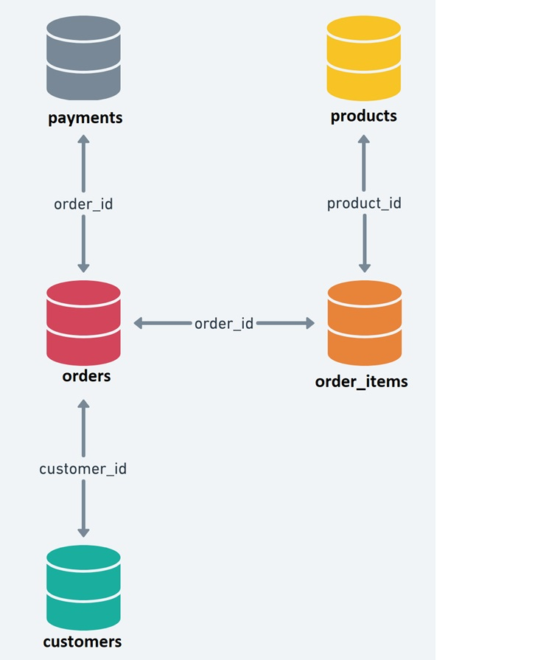
Entity Relationship Diagram (ERD)
To merge all sheets in the "Retail_dataset" using the common fields outlined in the Entity Relationship Diagram (ERD).

Slide 22

Thank you
Subhasish Das
Subhasish.das09@gmail.com

